Slide 1
Chapter 1: Introductory Concepts

Slide 2
Chapter Objectives
After studying this chapter, students should be able to:
• Explain the basic differences between digital and analog quantities
• Show how voltage levels are used to represent digital quantities
• Describe various parameters of a pulse waveform such as rise time, fall time, pulse width, frequency, period, and duty cycle
• Explain the basic logic functions of NOT, AND, and OR
• Describe several types of logic operations and explain their application in an example system
• Describe programmable logic, discuss the various types, and describe how PLDs are programmed
• Identify fixed-function digital integrated circuits according to their complexity and the type of circuit packaging
• Identify pin numbers on integrated circuit packages
• Recognize various instruments and understand how they are used in measurement and troubleshooting digital circuits and systems

Slide 3
Chapter Outline
1.1 Digital and Analog Quantities 1.2 Binary Digits, Logic Levels, and Digital Waveforms 1.3 Basic Logic Functions 1.4 Combinational and Sequential Logic Functions 1.5 Introduction to Programmable Logic 1.6 Fixed-Function Logic Devices 1.7 Test and Measurement Instruments 1.8 Introduction to Troubleshooting Multiple-choice test and Problems

Slide 4
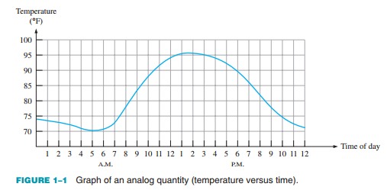
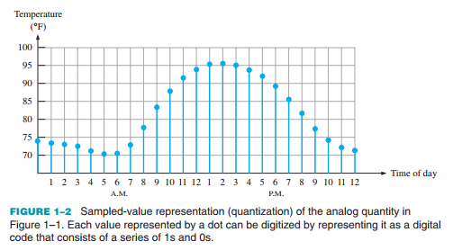
1.1. Digital and Analog Quantities
Electronic circuits can be divided into two broad categories, digital and analog.
Define analog
Define digital
Explain the difference between digital and analog quantities
The advantages of digital over analog
An analog quantity is one having continuous values. A digital quantity is one having a discrete set of values.

Slide 5
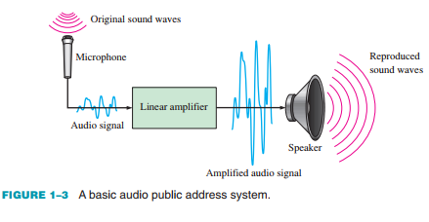
1.1. Digital and Analog Quantities
An Analog System

Slide 6
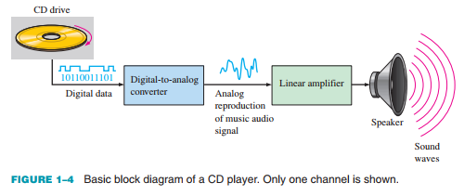
1.1. Digital and Analog Quantities
A System Using Digital and Analog Methods

Slide 7
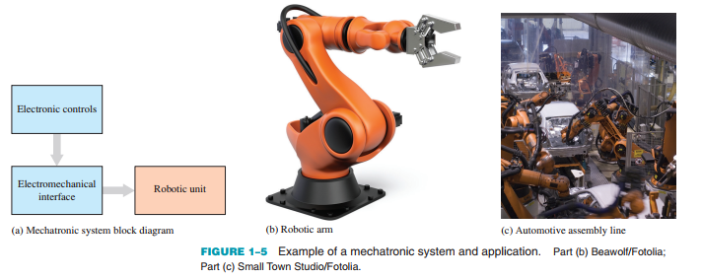
1.1. Digital and Analog Quantities
Mechatronics
Both digital and analog electronics are used in the control of various mechanical systems. The interdisciplinary field that comprises both mechanical and electronic components is known as mechatronics.

Slide 8
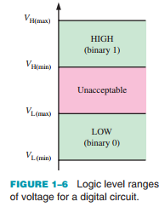

1.2. Binary Digits, Logic Levels, and Digital Waveforms
Binary Digits
Each of the two digits in the binary system, 1 and 0, is called a bit, which is a contraction of the words binary digit. In digital circuits, two different voltage levels are used to represent the two bits.

Slide 9
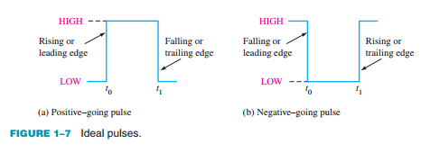
1.2. Binary Digits, Logic Levels, and Digital Waveforms
Digital Waveforms
Digital waveforms consist of voltage levels that are changing back and forth between the HIGH and LOW levels or states.

Slide 10
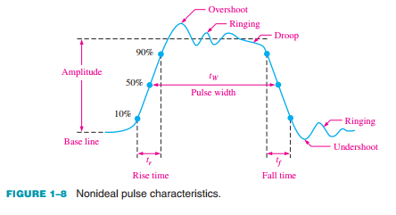
1.2. Binary Digits, Logic Levels, and Digital Waveforms
The Pulse

Slide 11
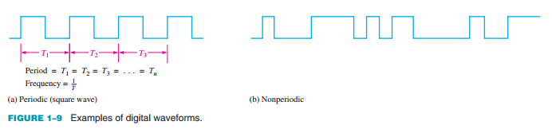
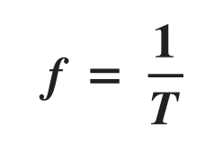


1.2. Binary Digits, Logic Levels, and Digital Waveforms
Waveform Characteristics
Most waveforms encountered in digital systems are composed of series of pulses, sometimes called pulse trains, and can be classified as either periodic or nonperiodic.

Slide 12
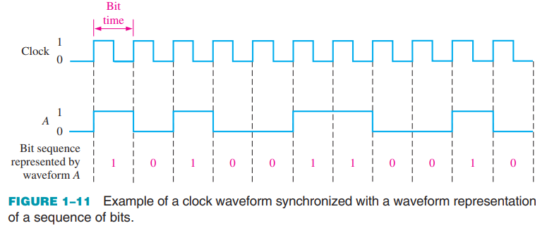
1.2. Binary Digits, Logic Levels, and Digital Waveforms
The Clock
In digital systems, all waveforms are synchronized with a basic timing waveform called the clock. The clock is a periodic waveform in which each interval between pulses (the period) equals the time for one bit.

Slide 13
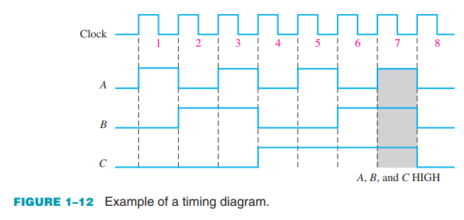
1.2. Binary Digits, Logic Levels, and Digital Waveforms
Timing Diagrams
A timing diagram is a graph of digital waveforms showing the actual time relationship of two or more waveforms and how each waveform changes in relation to the others.

Slide 14
1.2. Binary Digits, Logic Levels, and Digital Waveforms
Timing Diagrams
A timing diagram is a graph of digital waveforms showing the actual time relationship of two or more waveforms and how each waveform changes in relation to the others.

Slide 15
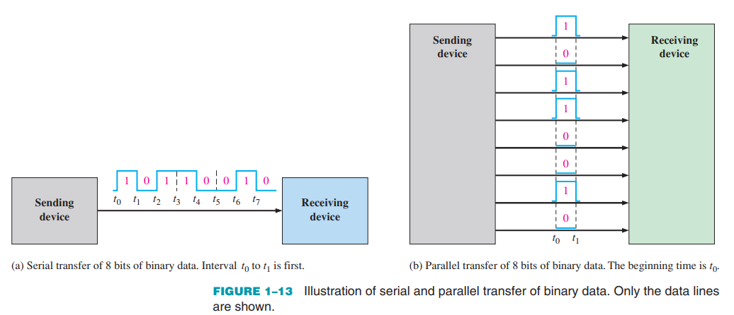
1.2. Binary Digits, Logic Levels, and Digital Waveforms
Data Transfer Data refers to groups of bits that convey some type of information. Binary data, which are represented by digital waveforms, must be transferred from one device to another within a digital system or from one system to another in order to accomplish a given purpose.

Slide 16
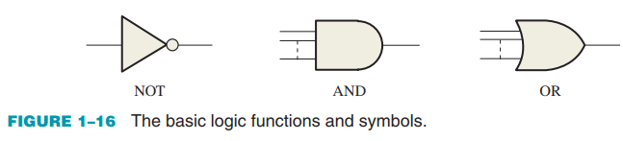
1.3. Basic Logic Functions
Three basic logic functions (NOT, AND, and OR) are indicated by standard distinctive shape symbols

Slide 17

1.3. Basic Logic Functions
NOT GATE
When the input is HIGH (1), the output is LOW (0). When the input is LOW, the output is HIGH. In either case, the output is not the same as the input. The NOT function is implemented by a logic circuit known as an inverter.

Slide 18
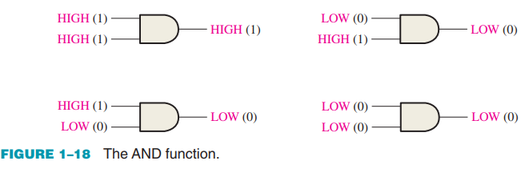
1.3. Basic Logic Functions
AND GATE When one input is HIGH and the other input is HIGH, the output is HIGH. When any or all inputs are LOW, the output is LOW. The AND function is implemented by a logic circuit known as an AND gate.

Slide 19
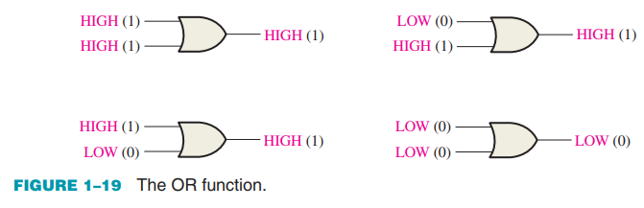
1.3. Basic Logic Functions
OR GATE When one input is HIGH or the other input is HIGH or both inputs are HIGH, the output is HIGH. When both inputs are LOW, the output is LOW. The OR function is implemented by a logic circuit known as an OR gate.

Slide 20
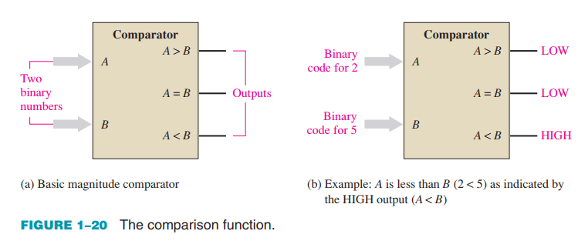
1.4. Combinational and Sequential Logic Functions
The Comparison Function Magnitude comparison is performed by a logic circuit called a comparator.

Slide 21
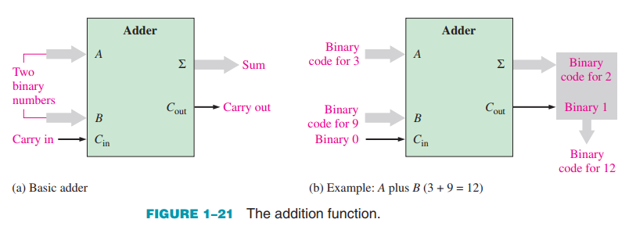
1.4. Combinational and Sequential Logic Functions
The Arithmetic Functions
Addition Addition is performed by a logic circuit called an adder

Slide 22
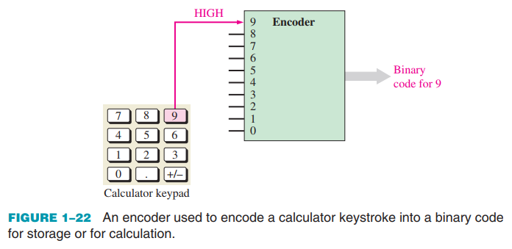
1.4. Combinational and Sequential Logic Functions
The Encoding Function
The encoding function is performed by a logic circuit called an encoder.

Slide 23
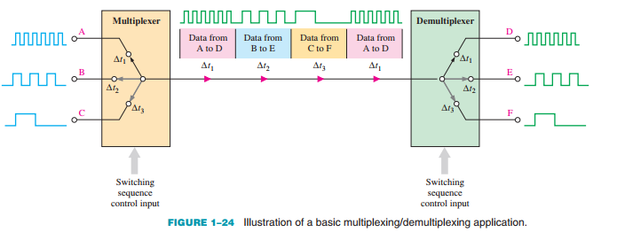
1.4. Combinational and Sequential Logic Functions
The Data Selection Function Two types of circuits that select data are the multiplexer and the demultiplexer. The multiplexer, or mux for short, is a logic circuit that switches digital data from several input lines onto a single output line in a specified time sequence.

Slide 24
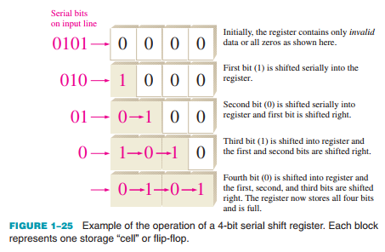
1.4. Combinational and Sequential Logic Functions
Registers A register is formed by combining several flip-flops so that groups of bits can be stored.

Slide 25
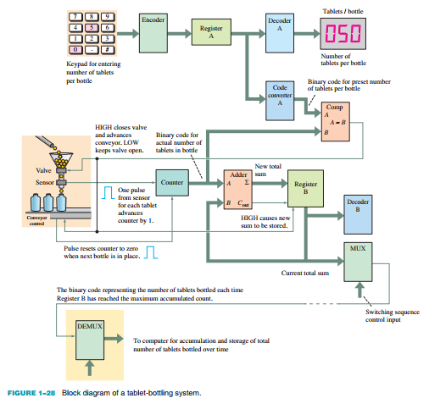
1.4. Combinational and Sequential Logic Functions
General Operation The maximum number of tablets per bottle is entered from the keypad, changed to a code by the Encoder, and stored in Register A.

Slide 26
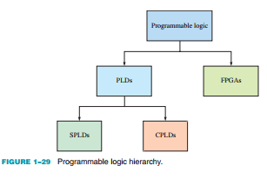
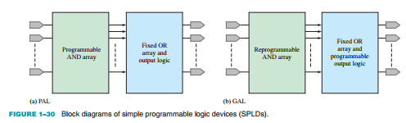
1.5. Introduction to Programmable Logic
Programmable Logic Devices (PLDs) Two major categories of user-programmable logic are PLD (programmable logic device) and FPGA (field-programmable gate array), as indicated in Figure 1–29. PLDs are either SPLDs (simple PLDs) or CPLDs (complex PLDs).

Slide 27
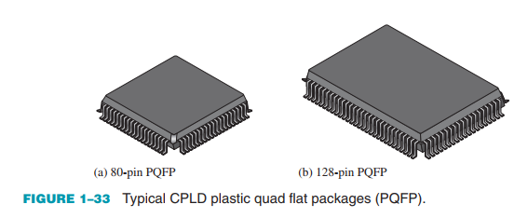
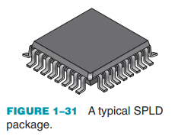
1.5. Introduction to Programmable Logic
Simple Programmable Logic Device (SPLD) The SPLD was the original PLD and is still available for small-scale applications.
Complex Programmable Logic Device (CPLD) As technology progressed and the amount of circuitry that could be put on a chip (chip density) increased, manufacturers were able to put more than one SPLD on a single chip and the CPLD was born.

Slide 28
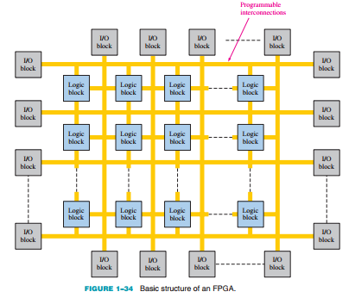
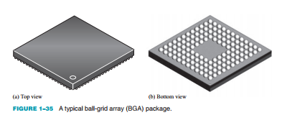
1.5. Introduction to Programmable Logic
Field-Programmable Gate Array (FPGA) An FPGA is generally more complex and has a much higher density than a CPLD, although their applications can sometimes overlap.

Slide 29
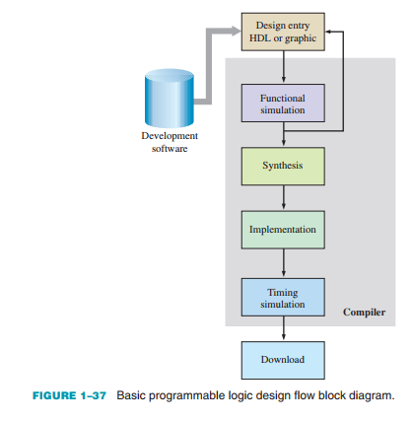
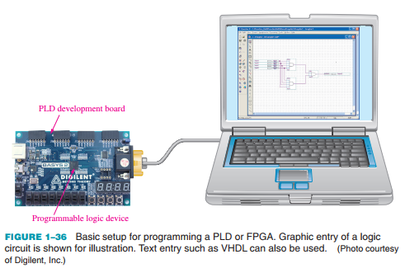
1.5. Introduction to Programmable Logic
The Programming Process An SPLD, CPLD, or FPGA can be thought of as a “blank slate” on which you implement a specified circuit or system design using a certain process.

Slide 30
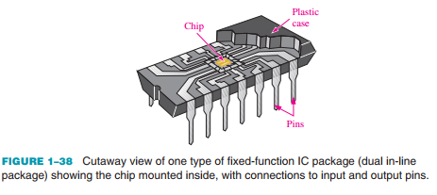
1.6. Fixed-Function Logic Devices
A monolithic integrated circuit (IC) is an electronic circuit that is constructed entirely on a single small chip of silicon. All the components that make up the circuit—transistors, diodes, resistors, and capacitors—are an integral part of that single chip. Fixed-function logic and programmable logic are two broad categories of digital ICs. In fixed-function logic devices, the logic functions are set by the manufacturer and cannot be altered.

Slide 31
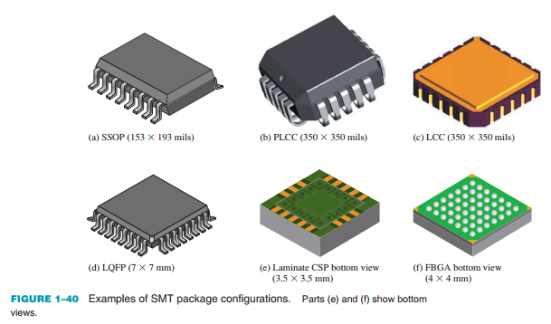
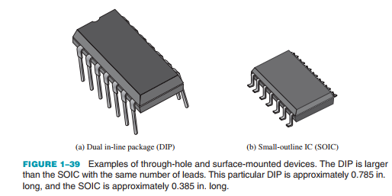
1.6. Fixed-Function Logic Devices
IC Packages Integrated circuit (IC) packages are classified according to the way they are mounted on printed circuit boards (PCBs) as either through-hole mounted or surface mounted.

Slide 32
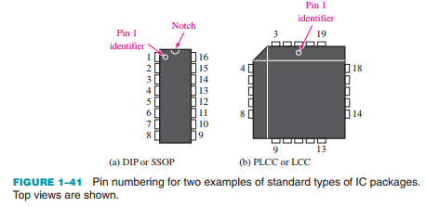
1.6. Fixed-Function Logic Devices
Pin Numbering All IC packages have a standard format for numbering the pins (leads).

Slide 33
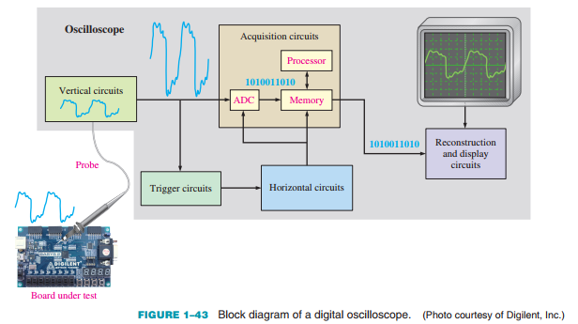
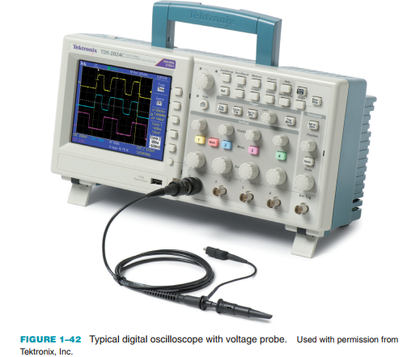
1.7. Test and Measurement Instruments
The Oscilloscope The oscilloscope (scope for short) is one of the most widely used instruments for general testing and troubleshooting.

Slide 34
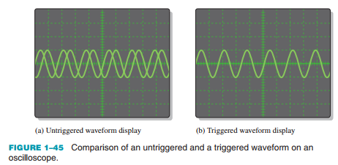
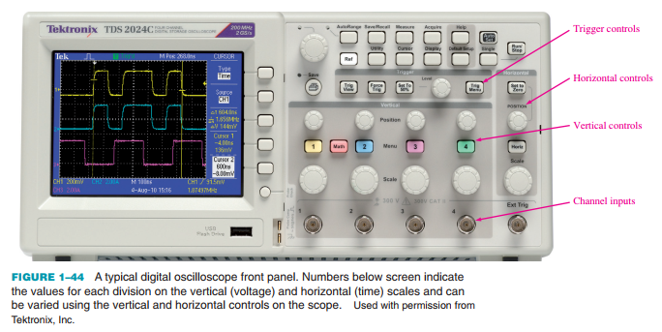
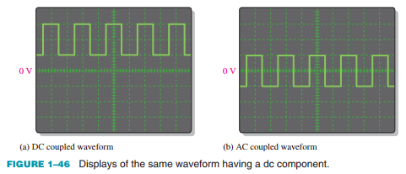
1.7. Test and Measurement Instruments
Oscilloscope Controls A front panel view of a typical four-channel digital oscilloscope

Slide 35
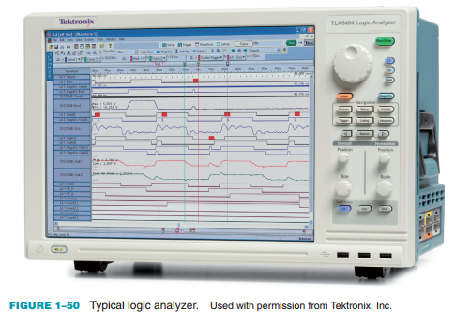
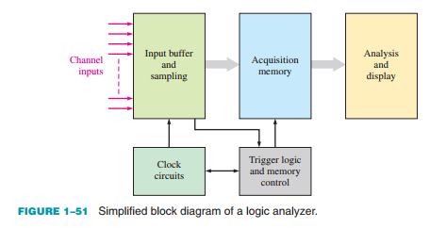
1.7. Test and Measurement Instruments
The Logic Analyzer Logic analyzers are used for measurements of multiple digital signals and measurement situations with difficult trigger requirements.

Slide 36
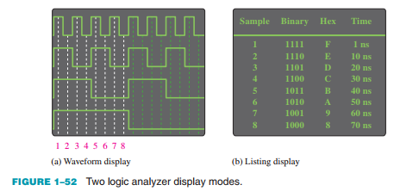
1.7. Test and Measurement Instruments
Analysis and Display Once data has been sampled and stored in the acquisition memory, it can typically be used in several different display and analysis modes.

Slide 37
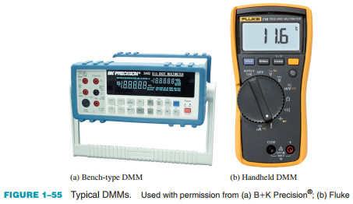
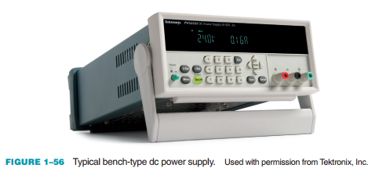
1.7. Test and Measurement Instruments
The DC Power Supply This instrument is an indispensable instrument on any test bench.

Slide 38
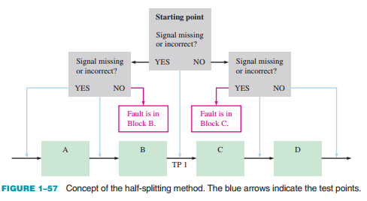
1.8. Introduction to Troubleshooting
Half-Splitting Method In this procedure, you check for the presence or absence of a signal at a point halfway between input and output.

Slide 39
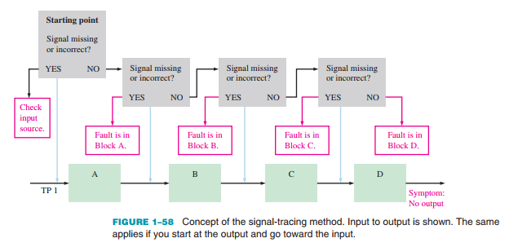
1.8. Introduction to Troubleshooting
Signal-Tracing Method Signal tracing is the procedure of tracking signals as they progress through a system from input to output.

Slide 40

SUMMARY
Chapter 1: Introduction Concepts
Analog signals are continuous; digital signals have discrete values. Frequency and period are inversely related:
Duty cycle is the ratio of pulse width to period, and basic logic operations include NOT, AND, OR with standard symbols.
PLDs include SPLDs (e.g., PAL, GAL) and CPLDs, while FPGAs are used for more complex designs.
ICs are categorized by packaging (through-hole, surface-mounted), logic families (CMOS, TTL/Bipolar, BiCMOS), and complexity levels (SSI to ULSI).
Key tools for testing digital circuits include oscilloscopes, logic analyzers, multimeters, and power supplies. Troubleshooting methods include half-splitting and signal-tracing.

Slide 41
MULTIPLE-CHOICE TEST AND PROBLEMS
Complete the true/false questions, multiple-choice questions, and end-of-chapter exercises in the primary textbook.

